Slide 1
Le Grande Tour of FPGA Land
Jim Brakefield

Slide 2
Introduction
LEGO Land:
2.5M LUTs running at 500MHz = ~10¹⁵ ops/sec
uP Star-Trek slogan:
Take microprocessors (uP) where no uP has gone before
FPGA Dr. Who slogan:
FPGAs are for Time Lords: you have both time & space at your disposal

Slide 3
FPGA (Field Programmable Gate Array) Table of Contents
FPGA 101
FPGA vendors
FPGA tools
Sample project
IP & 3rd party designs
FPGA 201
Monster FPGAs
Neat projects
Literature & Videos
Design guidelines
Personal insights
Vendor histories
References

Slide 4
FPGA 101
LUT Lookup table, 3..6 inputs, 1..2 out
DFF D flip-flop, 1..2 per LUT
IO Tristate transceiver with optional DFF
Block RAM Dual port, .5K to 300K bits, variable aspect ratio
Wiring Fabric Horizontal and vertical wire segments of various lengths

Slide 5
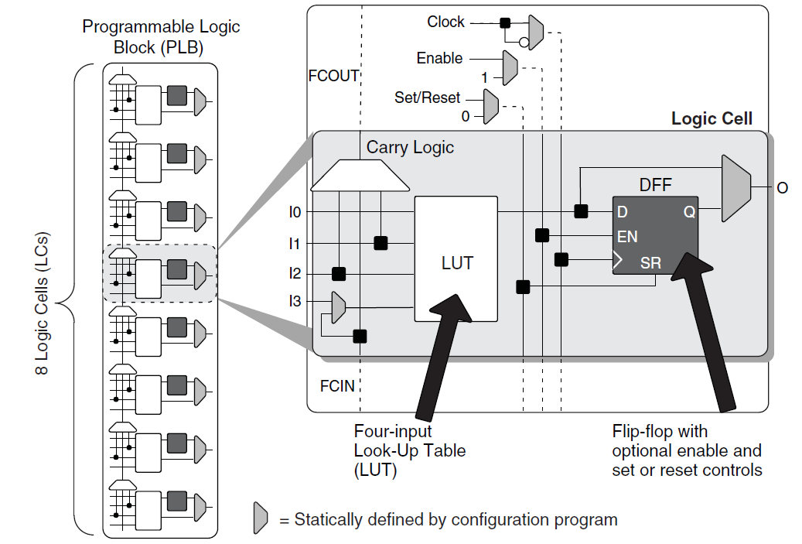
LUT + DFF Lattice Semiconductor iCE40FamilyHandbook.pdf pg6-2

Slide 6
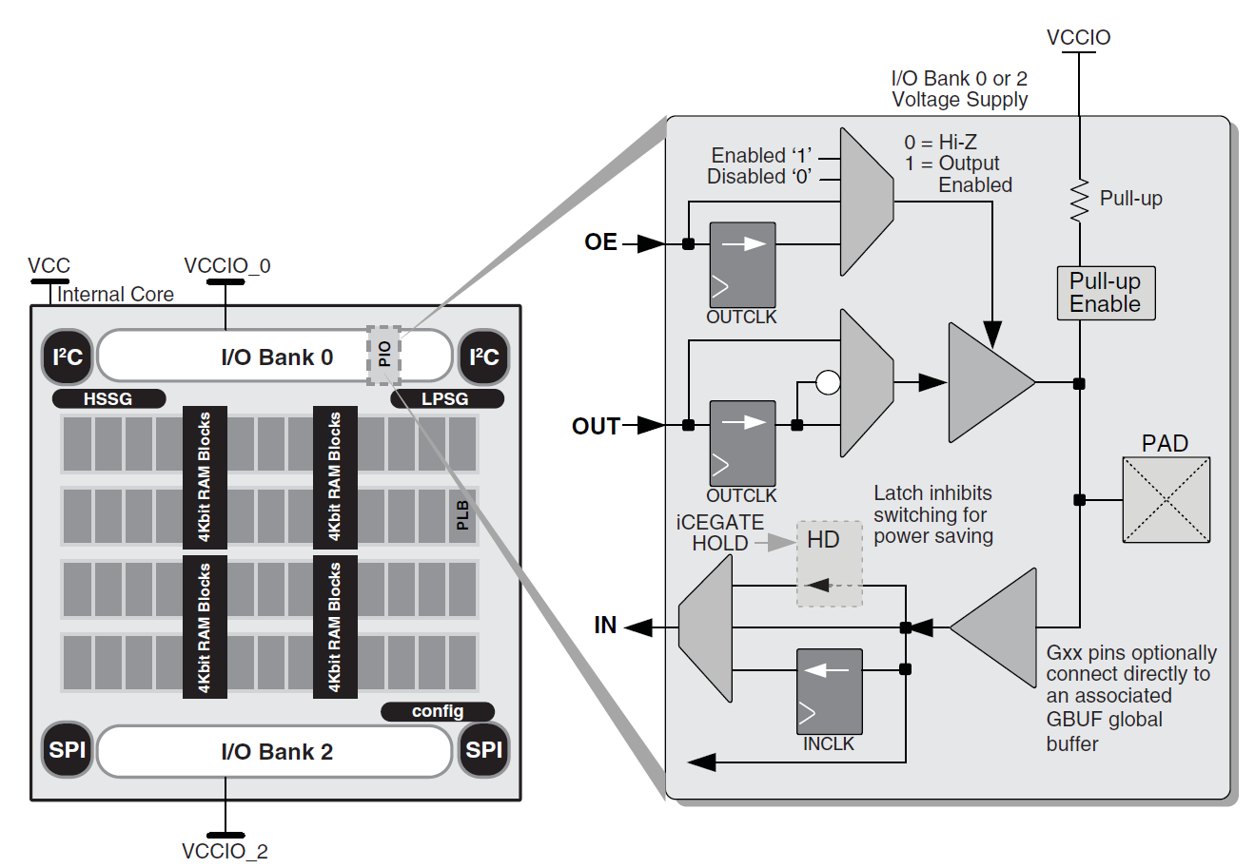
Input – Output pins Lattice Semiconductor iCE40FamilyHandbook.pdf pg6-7

Slide 7
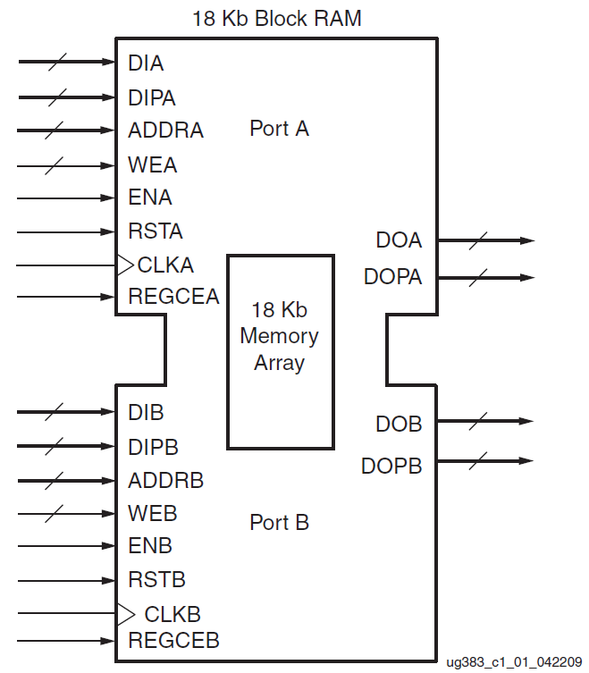
Block RAM Xilinx Spartan-6 FPGA Block RAM Resources User Guide pg12

Slide 8
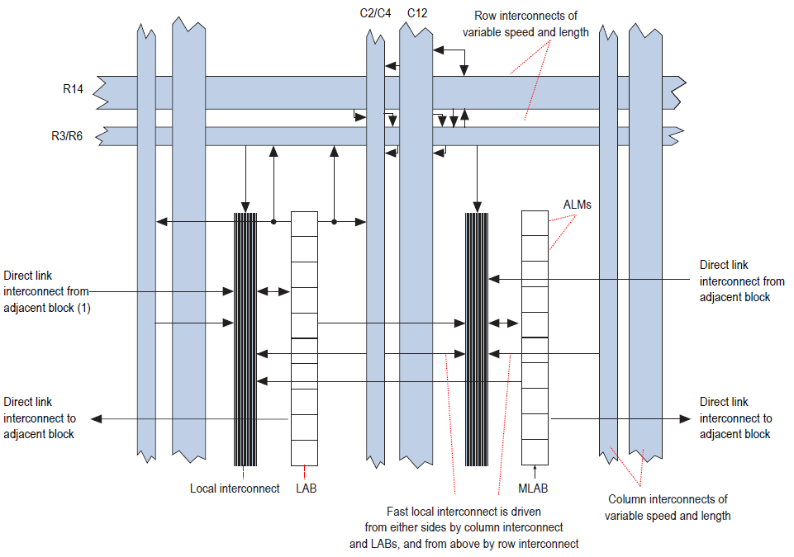
Wiring Fabric Altera CycloneV Device Handbook pg1-2

Slide 9
FPGA Vendors
Name web site market share revenue
Xilinx Xilinx.com 51% $2.4B
Altera Altera.com 34% $1.9B
Lattice Semiconductor ~7% $0.4B
Latticesemi.com
Microsemi Actel.com ~7% $0.4B?
Cypress Cypress.com ? ?

Slide 10
FPGA Tools
HDL (Hardware Design Languages)
VHDL, Verilog, System Verilog
Also High Level Synthesis(HLS): C, C++, Matlab
HDL generators: MyHDL(Python), Haskell
Compilation HDL into “gates” & DFF
Place & Route Vendor proprietary
Timing analysis How fast will it run?
Simulation Unit testing on a PC
Download Transfer bit file to the chip

Slide 11
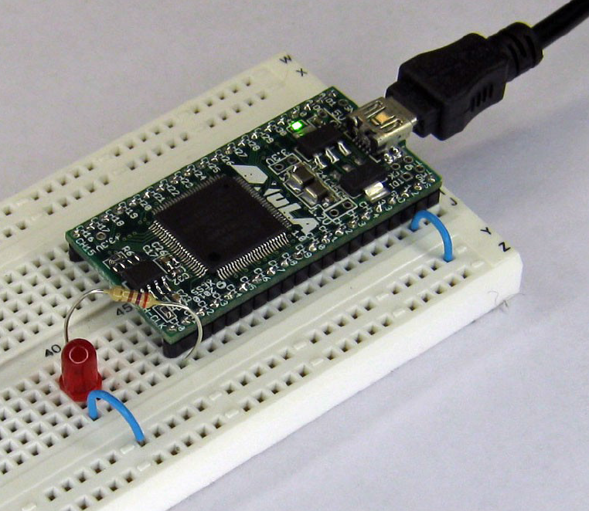
Hello World for FPGAs XESS: FPGAs!? Now What? pg60

Slide 12
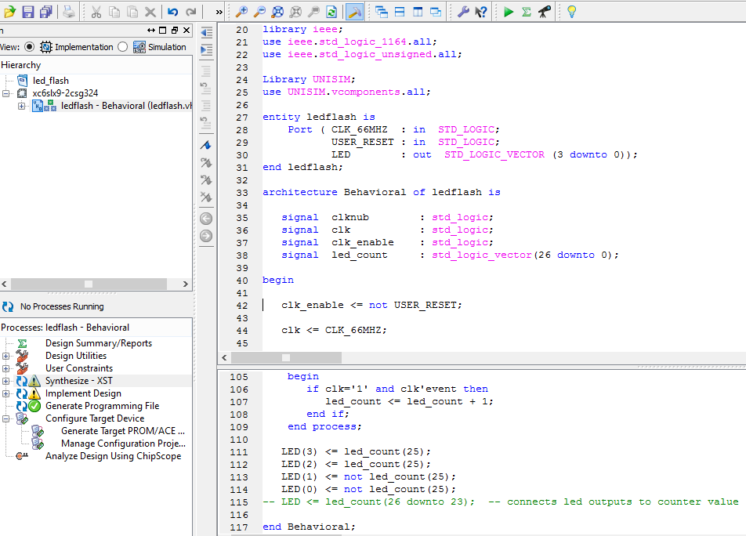
FPGA “Hello World” HDL

Slide 13
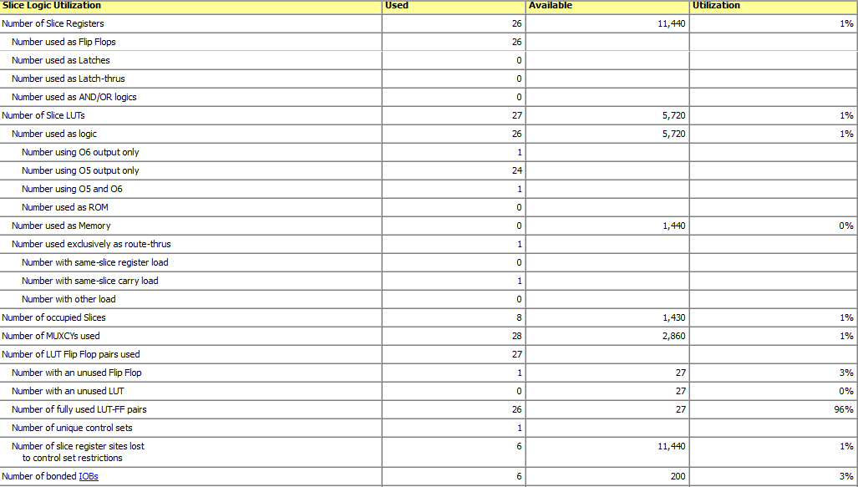
Hello World resource usage

Slide 14
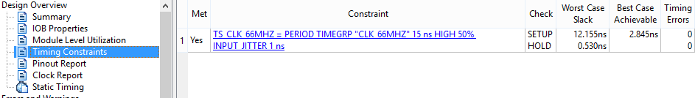
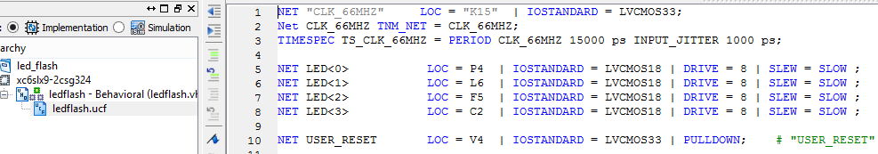
Hello World Fmax & constraint file

Slide 15
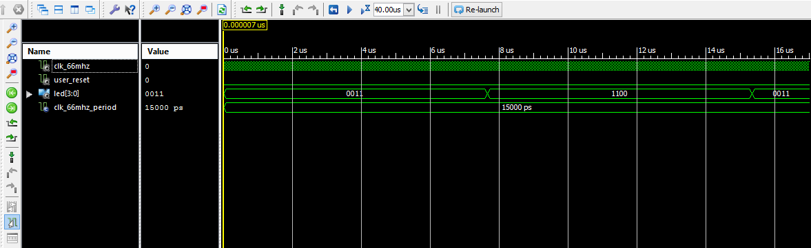
Hello World simulation counter tapped at bit 9

Slide 16
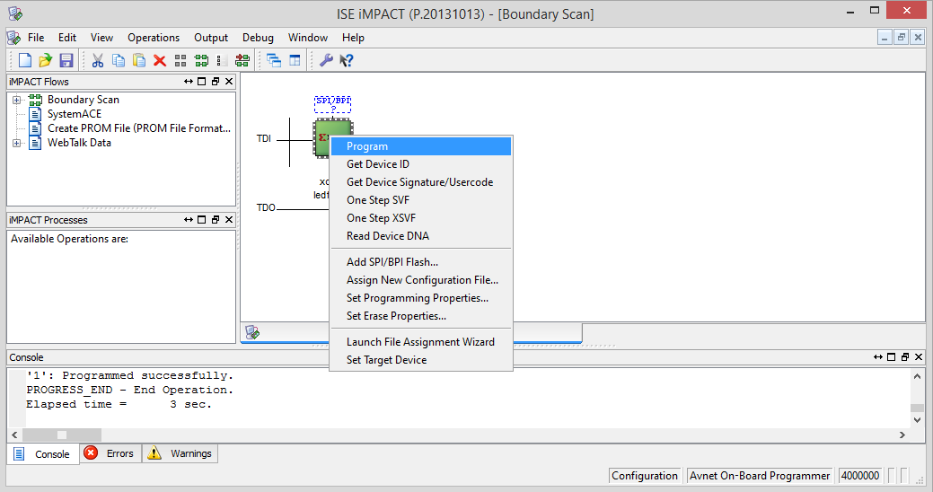
Hello World download

Slide 17
IP (Intellectual Property) Pre-packaged HDL modules
Opencores.org
Hundreds of free designs in 16 categories
FPGA vendor IP: Generally fairly simple
CORDIC: Coordinate Rotation Digital Computer
Soft processor cores
Xilinx micro Blaze
Altera NIOS II
Altium TSK3000A
Not Free: Licensing terms vary

Slide 18
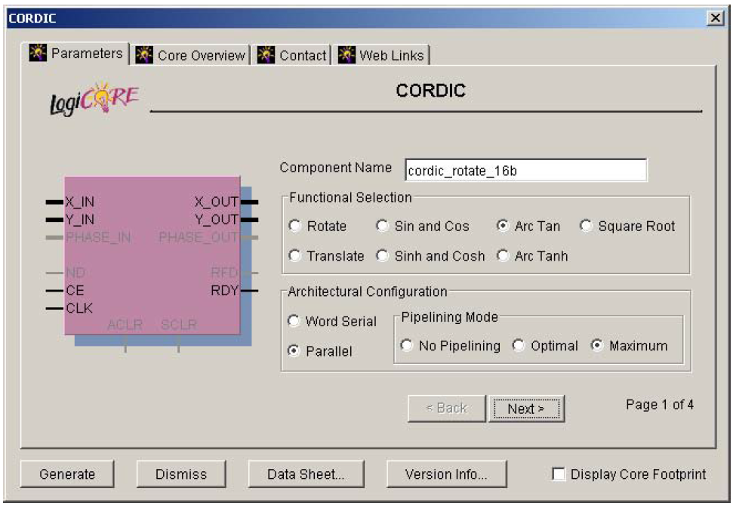
Xilinx CORDIC GUI Ray Andraka 1998: A survey of CORDIC algorithms for FPGA based computers

Slide 19
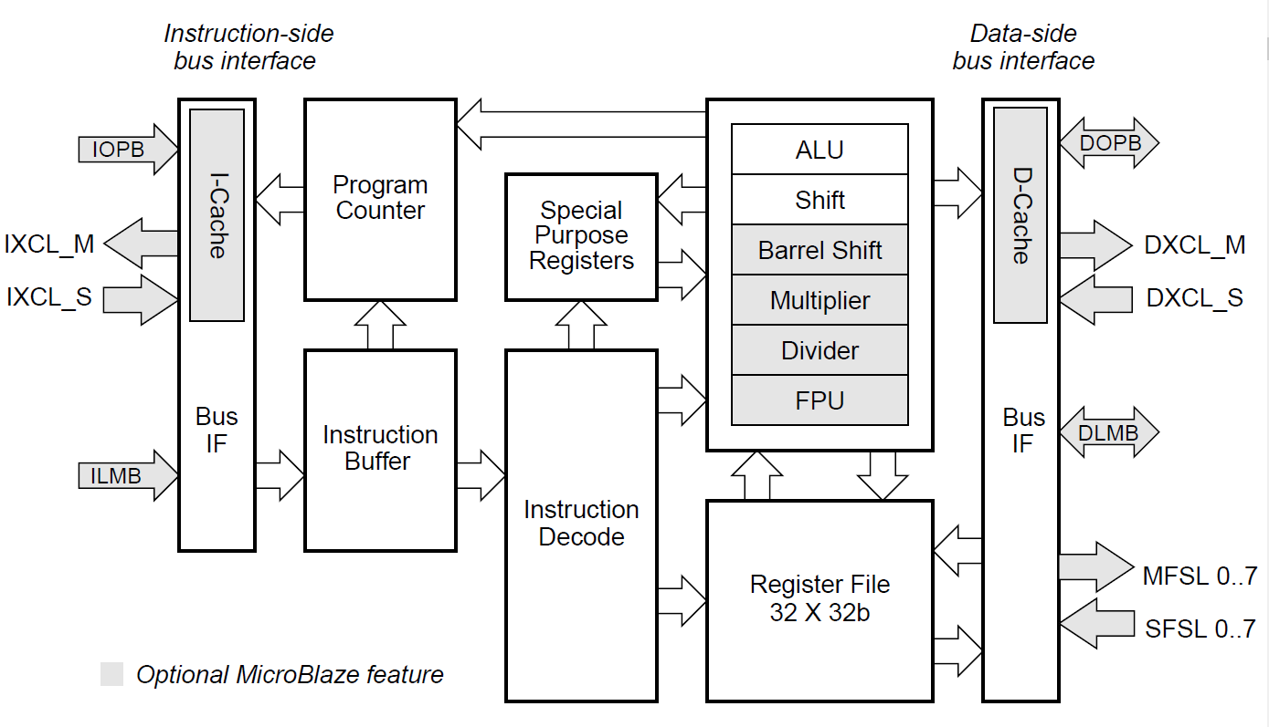
Micro Blaze Core Block Diagram Xilinx MicroBlaze Processor Reference Guide pg11

Slide 20
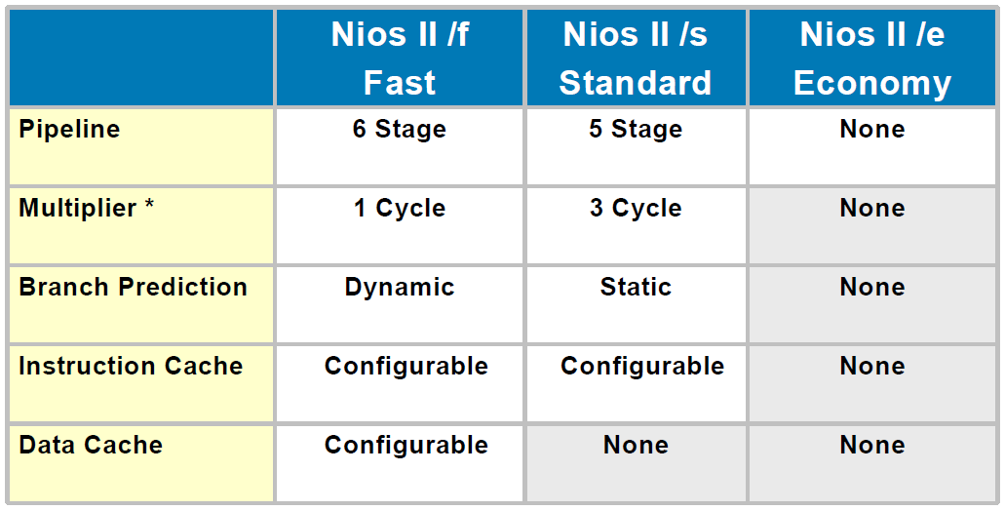
Key features of Nios II family members Altera Nios II Embedded Processor Backgrounder pg1

Slide 21
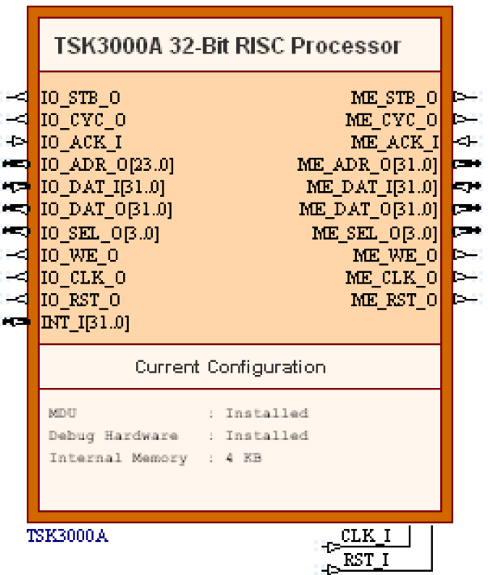
TSK3000A 32-Bit RISC Processor Altium TSK3000A Summary

Slide 22
FPGA 201
6LUT/ALM 4:1 mux, 3-input adder
LUT RAM asynchronous read, sync write
Multipliers 9x9 to 27x27 with accumulator
PLL/DLL Phase/Delay Locked Loop
LVDS Low Voltage Differential Signaling
DDR controller Uses ordinary IO pins
DDR, DDR2, DDR3, DDR4, LPDDR, QDR, RLDDR3
uP cores: ARM Cortex A9 & Cortex M3, ARM v8
SERDES Very high speed serial IO

Slide 23
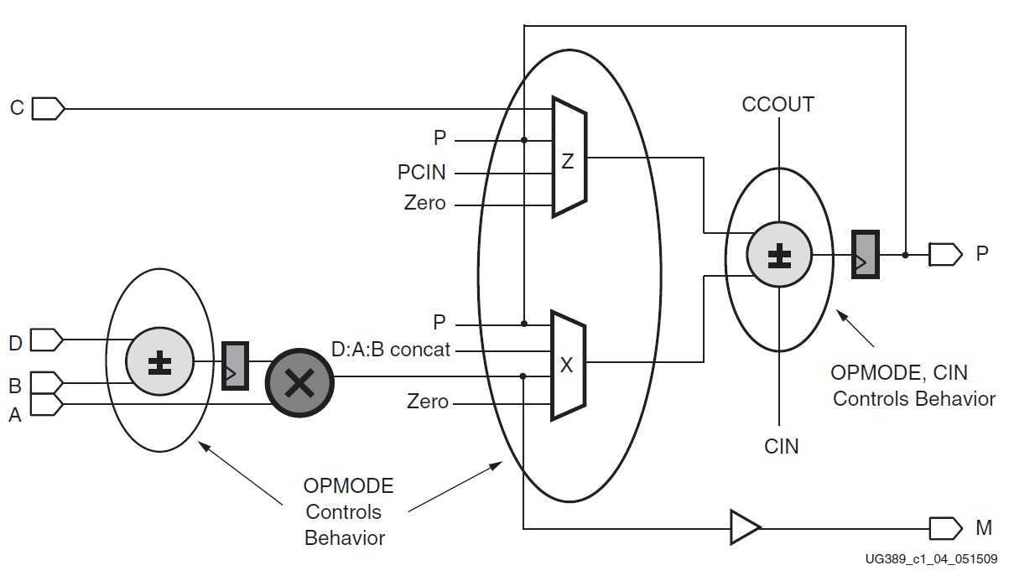
Simplified DSP48A1 slice Xilinx Spartan-6 FPGA DSP48A1 Slice pg 17

Slide 24
Monster FPGA chips
20nm shipping, 16nm later this year
2.5 million LUTs (shipping)
11K DSP units (5.5K shipping)
65MB block RAM (10MB shipping)
Quad-core 64-bit ARM v8 +Mali 400 +H265 codec
Floating-point DSP (1.5K shipping)
1K LUTs/dollar (shipping)
850MHz DSP Fmax (740MHz shipping)
32.75Gbps SERDES (64 channels shipping)

Slide 25
FPGA evaluation kits all use USB download
Vendor Price FPGA “LUTs” Mults Comments
Arrow BeMicro MAX10 $30 Altera Max 10M08 8K 24 oscillator, 12-bit A2D, flash
Schmartboard PSoC5LP $35 Cypress PSoC5 384 0
Cortex M3, digital & analog
Arrow BeMicroCV $49 Altera Cyclone V 25K 50
Digilent Cmod S6 $69 Xilinx Spartan-6 4K 4 48-pin DIP
XESS XuLA2-LX9 $69 Xilinx Spartan-6 9K 16 40-pin DIP, SDRAM
Scarab Hardware miniSpartan6+ $75 Xilinx Spartan-6 9K 16 (2) HDMI, 32MB DRAM, microSD
Digilent ZYBO(student $) $125 Xilinx Zynq 7010 28K 80 (2) Cortex A9, 512MB, HDMI…
Adapteva Parallella-16 $149 Xilinx Zynq 7010 28K 80 (2) Cortex A9, 16-core uP

Slide 26
Neat Projects
Cray-1: Runs as fast as original, on $100 FPGA board
Mandelbrot set: PS2 display, 30 frames/sec
Milkymist: Video effects generator
Retro computers
PDP8
PDP11
PDP11/70

Slide 27
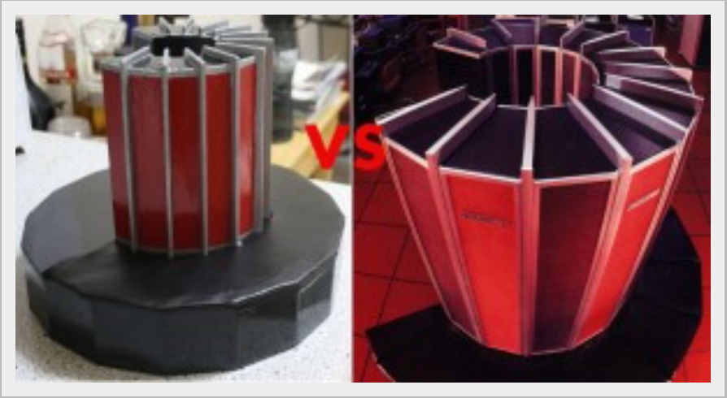
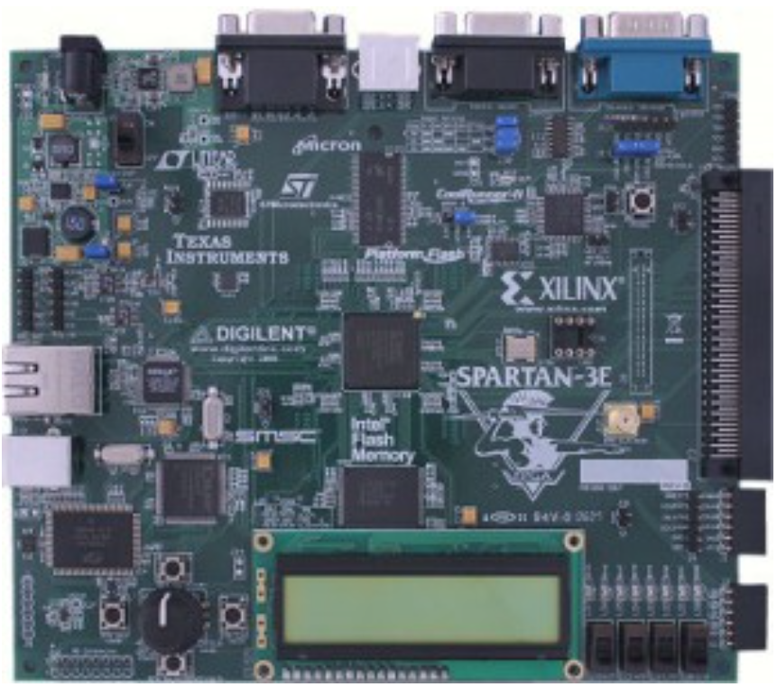
Cray-1 http://www.chrisfenton.com/homebrew-cray-1a/

Slide 28
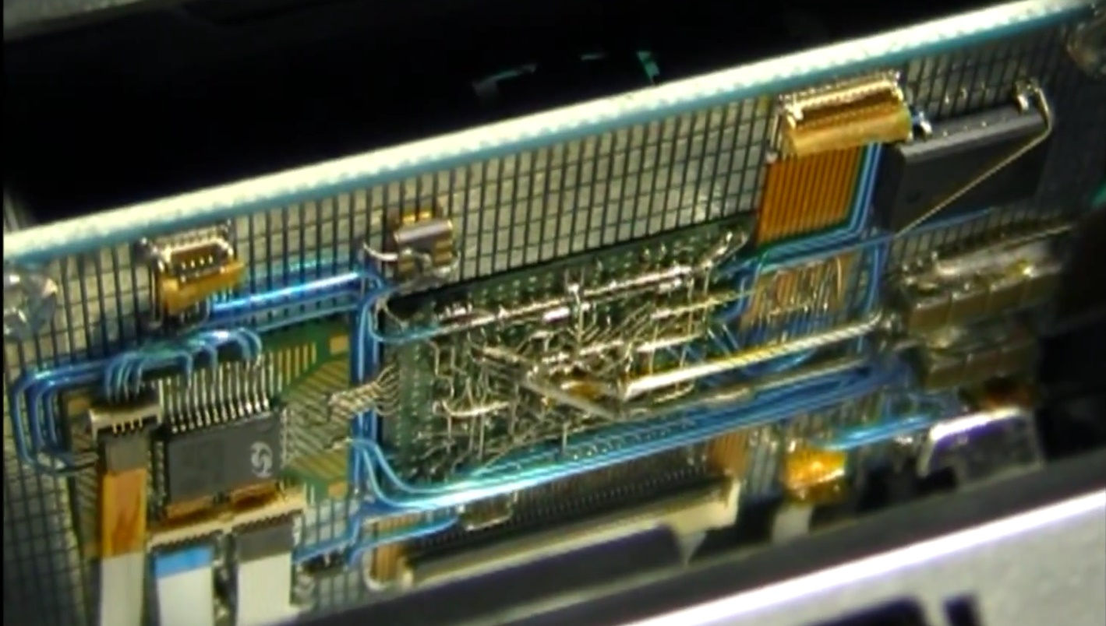
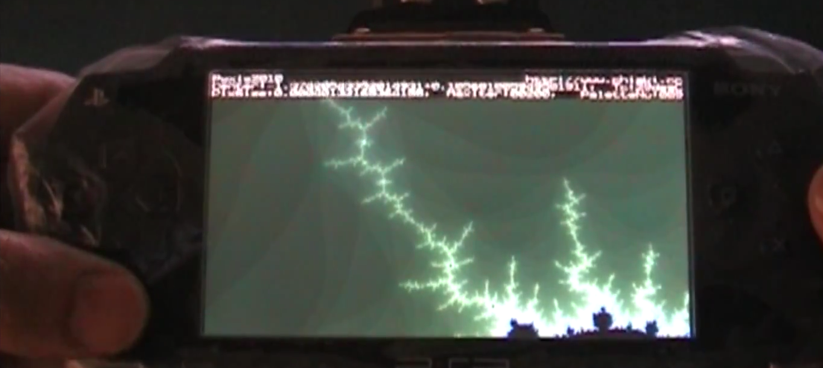
FPGA Mandelbrot set http://hackaday.com/2012/10/23/exploring-the-mandelbrot-set-in-real-time/

Slide 29
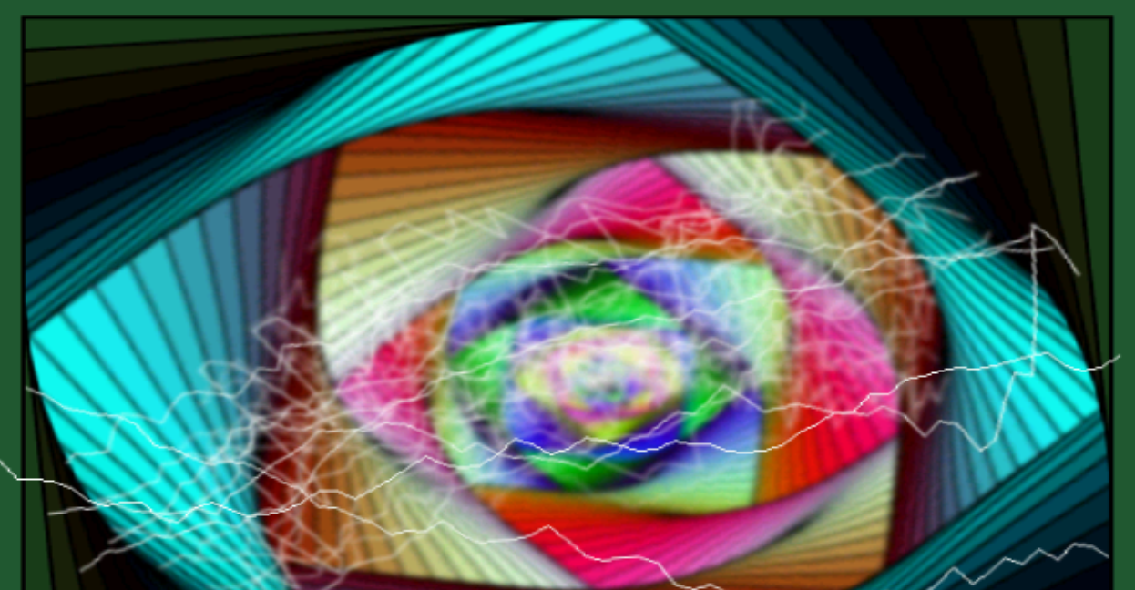
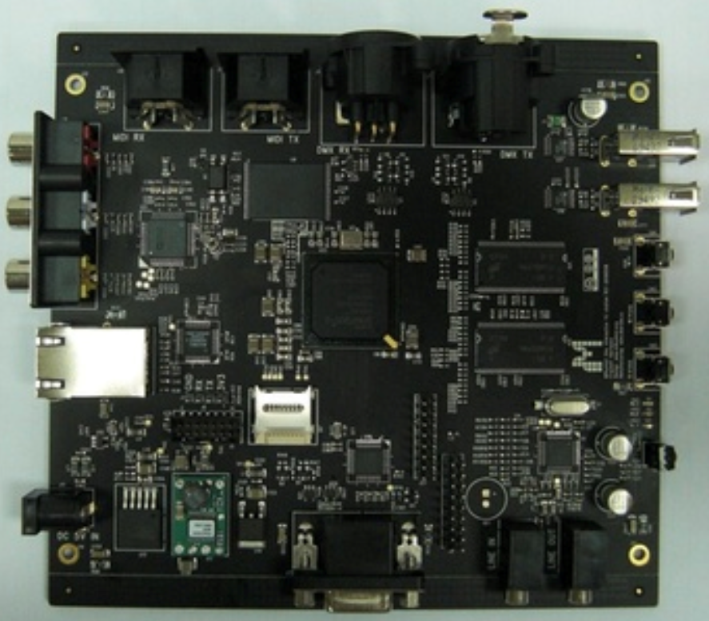
Milkymist One http://m-labs.hk/m1.html

Slide 30
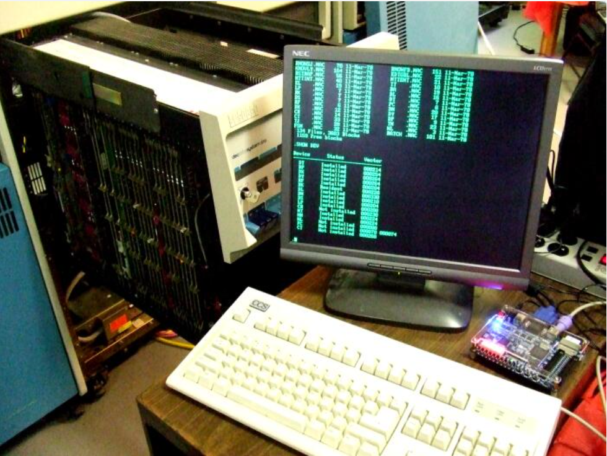
PDP11 retro computer http://pdp2011.sytse.net/wordpress/

Slide 31
FPGA Literature
Harris & Harris 2013: the very best textbook
Digital Design and Computer Architecture, 2nd ed.
Maxfield 2004: folksy, good at silicon
The Design Warrior’s Guide to FPGAs
Peter Chambers: free web PDF
The Ten Commandments of Excellent Design
Mealy & Tappero 2012: no-frills VHDL, free web PDF
Free Range VHDL

Slide 32
Videos & Training
Xilinx
http://www.xilinx.com/training/free-video-courses.htm
http://www.xilinx.com/support/university.html
Altera
https://www.altera.com/support/training/university/overview.html
Altium
https://altiumvideos.live.altium.com/

Slide 33
Ten Commandments for Successful Design
1. All state machine outputs shall always be registered
2. Thou shalt use registers, never latches
3. Thy state machine inputs, including resets, shall be synchronous
4. Beware fast paths lest they bite thine ankles
5. Minimize skew of thine clocks
6. Cross clock domains with the greatest of caution. Synchronize thy
signals!
7. Have no dead states in thy state machines
8. Have no logic with unbroken asynchronous feedback lest the fleas of
myriad Test Engineers infest thee
9. All decode logic must be crafted carefully—eschew asynchronicity
10. Trust not thy simulator—it may beguile thee when thy design is junk

Slide 34
David Harris & Sarah Harris 2013 Digital Design & Computer Architecture
From FET transistors to x86
VHDL and System Verilog side by side
Implements MIPS core three ways
Single clock
Multi-clock, e.g. state machine
Pipelined
Each chapter has interview questions
Forthcoming book with ARM implementation

Slide 35
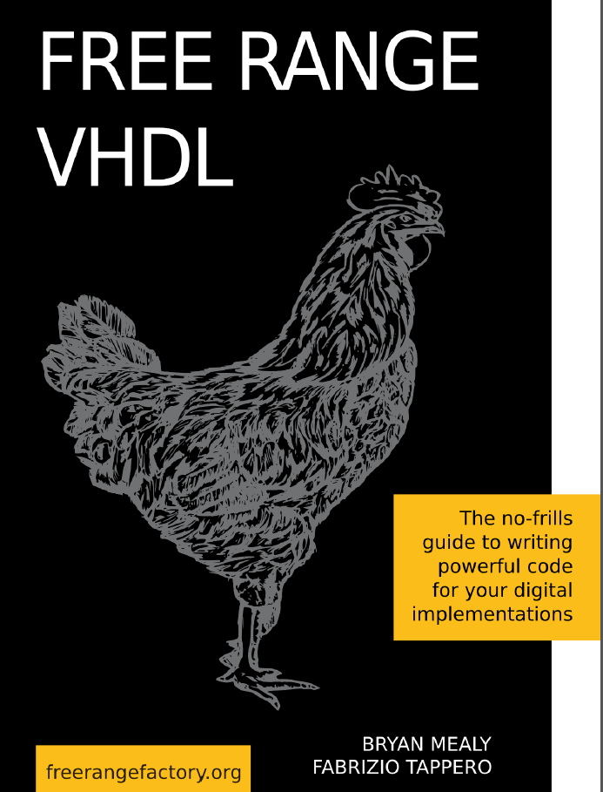
Free Range VHDL

Slide 36
Guidelines
“Fundamental mode”: Single clock, no latches
Two process VHDL:
Distinct combinational and sequential processes
Jiri Gaisler 2014: A structured VHDL design method
Metastability: when a signal crosses clock domains, setup & hold violations occur
VHDL, Verilog and System Verilog Quick Reference Cards

Slide 37
Insights
You are master of both time and space
Think like the compiler to write good code
Pack a FPGA over 80% full & timing suffers
Takes more effort than writing software
Large projects are team projects
Specialization occurs
FPGA knowhow is a necessary skill
Hands-on seminars often have eval kit bargins

Slide 38
Vendor History
Xilinx
Founded 1984 (31 years ago)
Invented the FPGA (Ross Freeman)
Has tried a number of FPGA architectures
Purchased AutoESL Design in 2011
Converts C, C++ or SystemC into VHDL or Verilog
Replaced ISE tool with Vivado in 2012

Slide 39
Vendor History
Altera
Founded 1983
PLD (Programmable Logic Device) market leader
Has migrated to a FPGA product line
Purchased Enpirion in 2013
Maker of DC2DC converters
Using Intel as a foundry for 22nm & 14nm parts

Slide 40
Vendor History
Lattice Semiconductor
Founded 1983
Originally made RAM
Major CPLD vendor
Bought Vantis (AMD spinoff) in 2000
Bought Agere FPGA group (Lucent spinoff) in 2002
Bought Silicon Blue (40nm low power startup)
Bought Silicon Image in 2015

Slide 41
Vendor History
Actel (now MicroSemi)
Founded 1985
Acquired by Microsemi Corp. in 2010
Anti-fuse FPGAs for military & space
Radiation tolerant
High reliability
Live on power-up
Mixed signal products in 2005
Have moved into the high security market

Slide 42
Books
Harris & Harris 2013: Digital Design and Computer Architecture, 2nd ed.
VHDL & System Verilog, all the way from 0s & 1s to x86
Max Maxfield 2004: The Design Warrior’s Guide to FPGAs
Folksy, good coverage at the chip level
Nazeih Botros 2006: HDL Programming Fundamentals – VHDL and Verilog
Side by side VHDL & Verilog
Peter Ashenden 2008: The Designer’s Guide to VHDL, 3rd ed.
The VHDL reference
Steve Kilts 2007: Advanced FPGA Design

Slide 43
Free PDFs
Mealy & Tappero 2012:
Free Range VHDL: A to-the-point VHDL text
Crockett etal 2014:
The Zynq Book: ARM Cortex A9 + FPGA
Jiri Gaisler 2014:
A structured VHDL design method
Ray Andraka 1998:
A survey of CORDIC algorithms for FPGA based computers

Slide 44
EDA (Electronic Design Automation)Tools
Xilinx ISE, Vivado
Altera Quartus
Actel Libero
Lattice Diamond
Cypress PSoC Creator
MathWorks MATLAB, Simulink
Synopsys Design Compiler, Synplicity
Mentor Exemplar, Precision, Model Sim
Aldec Active HDL
Altium PCB design, Schematic HDL, NanoBoards

Slide 45
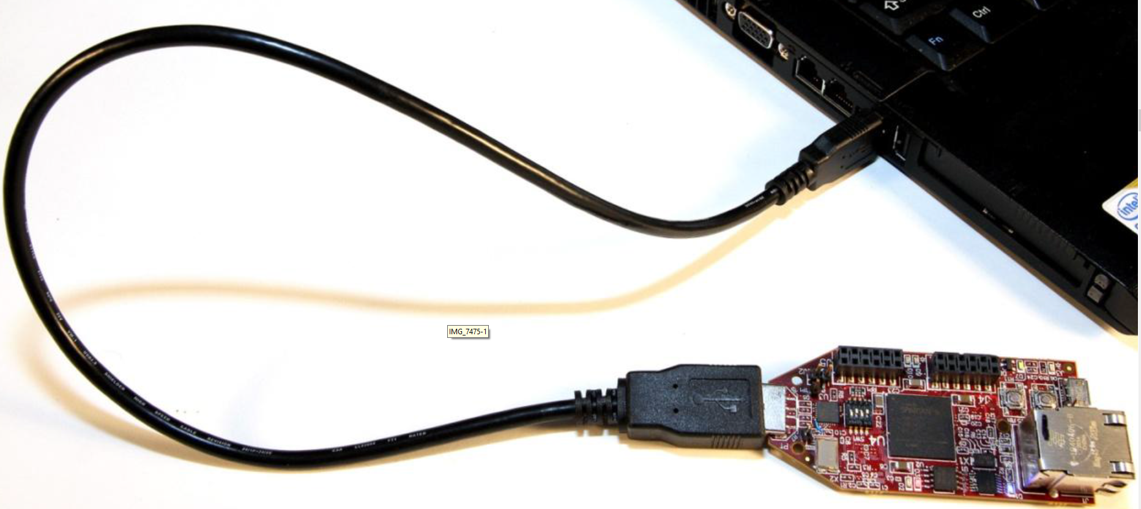
Hello World for FPGAs Avnet s6microboard

